Slide 1
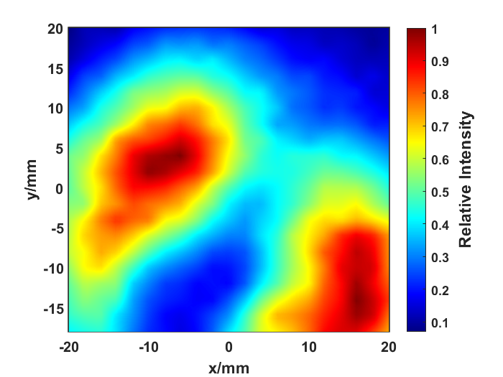
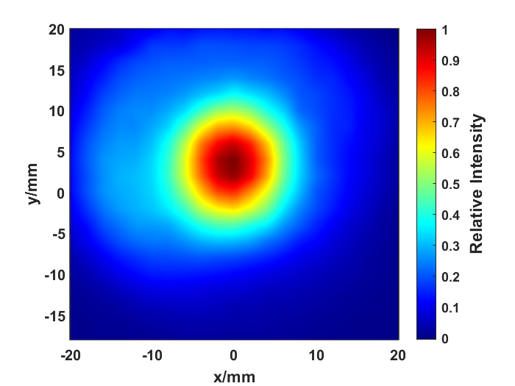
(a)
(b)

Slide 2
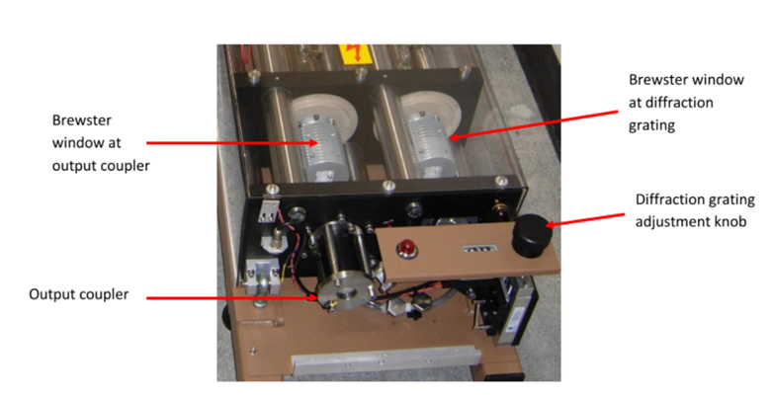
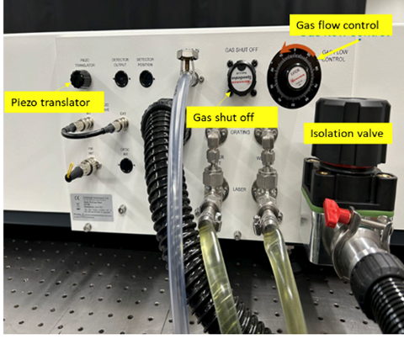


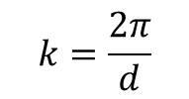

Incident wave
Scattering wave
$$k=\frac{2π}{d}$$
$$θ_{i}/2$$
d
Plasma turbulence
$$nλ=2dsinθ$$
$$k=2k_{i}sinθ$$
(a)
(b)

Slide 3
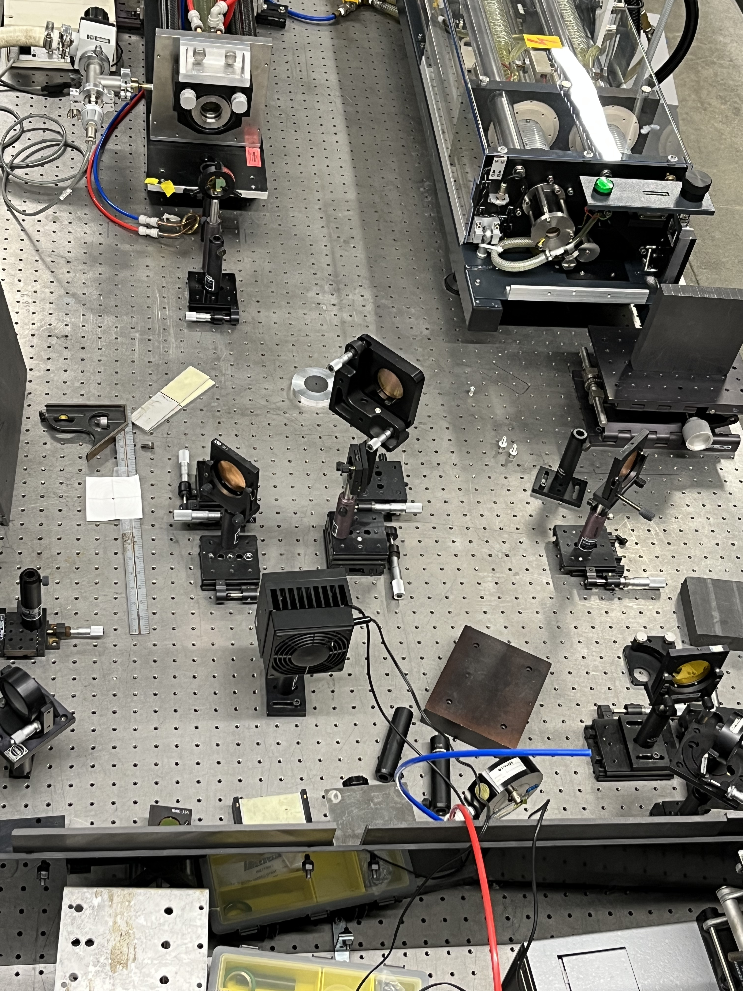
CO₂ laser system
FIR input window
CO₂ laser output window
Beam Splitter
mirror
Focus lens
mirror
Power Monitor

Slide 4
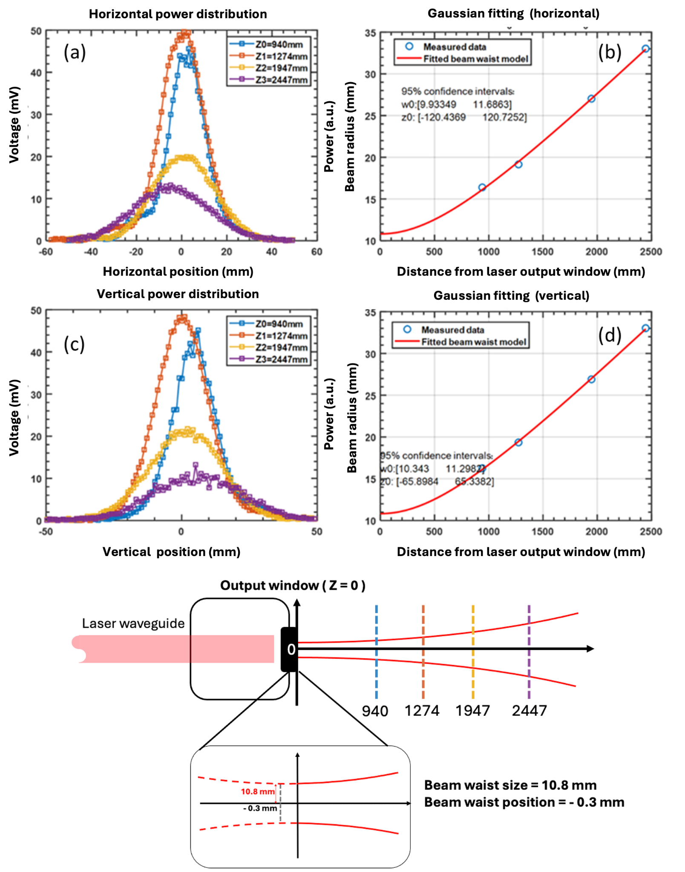
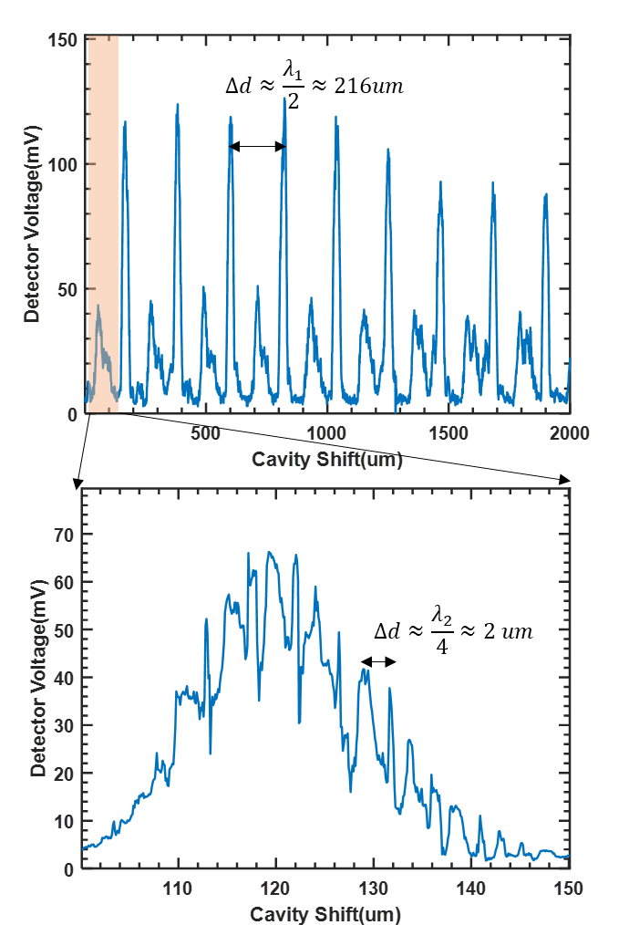


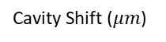
$$Δd≈\frac{λ_{1}}{2}≈216 μm$$
Cavity Shift ($μm$)
(e)
$$Δd≈\frac{λ_{2}}{2}≈2 μm$$
Cavity Shift ($μm$)

